Slide 1
TAXONOMY
Dr. Smriti Chitnis

Slide 2
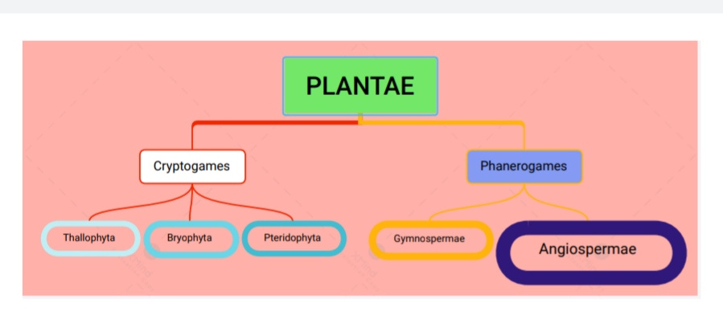
Angiosperms

Slide 3
CHARACTERS OF ANGIOSPERMS
This is the largest group of plants
They are the highest evolved plants on the surface of Earth
They were evolved in Cretaceous age and now are the dominant plant types.
They are found everywhere- in deserts, under water, on rocks, near sea shores, on or in other plants,
They are mostly phototrophs but insectivorous , saprophytes , parasites , symbionts and epiphytes are also common.

Slide 4
CHARACTERS OF ANGIOSPERMS
They may be annual, biennial and perennial
They may be herbs, shrubs, trees, climbers, twinners and lianes.
They may be minute as pinhead as Wolffia microcoppica or giants as Eucalyptus (height 300Ft)
Angiosperms (Gr. Angios = vessel or receptacle and Sperma = Seed) the ovules are borne in the closed sporophyll
The micro- and megasporophylls are arranged in flowers which may be bisexual or unisexual.
The pollen grains are received on the stigma of the carpel and the fertilization takes place by the development of the pollen tube
The two male gametes are without flagella, one fuses with egg and the other with secondary nucleus.

Slide 5
TAXA
Taxonomic group of any rank is called TAXON (plural –TAXA) for eg Species , genus, family , class
Study of taxa is known as TAXONOMY
HIERACCHY -
Species
Genus
Family
Order
Class
Division

Slide 6
Objectives of Taxonomy-
To know the various kinds of plants of Earth with their names, affinities, geographical distribution, habit, characteristics and their economic importance.
To ascertain the nomenclature
To demonstrate the manifold diversities of plant kingdom and their evolution
To develop a reference system for plants

